Slide 1



Module #3 – Software White-Box Testing Methods
Software Testing
Topic #2 – Software Basis Path Testing
Instructor: Jerry Gao, Ph.D., Professor
San Jose State University
Notes:
From this session, we start to talk about Topic #2 in Module #3 on Software White-Box Testing Methods.
In this package, we focuses on software basis path testing:
Topic #2 - Software Basis Path Testing
Topic #2 - Software Test Design
Topic #3 - Software Test Management

Slide 2
Topic #2 – Software Basis Path Testing
Software Testing
Flow Graph Model for White-Box Testing
Cyclomatic Complexity
Basis Path Testing Method
Basis Path Testing Tips
Basis Path Testing Coverage
Notes:
Now, we start module #3 of software testing.
This is the first package in Module 3 for Software Testing Class. Its purpose is to provide an overview of software white-box
Testing. It covers the following
What is white-box testing?
Why Is white-box testing important?
Who does white-box testing?
White-box testing focuses
White-box testing coverage

Slide 3
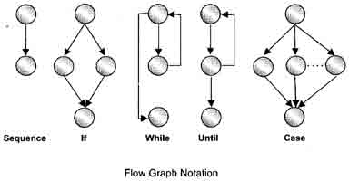
Topic #2 – Software Basis Path Testing
Software Testing
What is a program flow graph?
Definition: --> A program flow is a graph model which is useful to present the control flows for a program. Each program flow graph consists of a set of nodes and edges (or links).
A program flow graph can be used as a test model for white-box program testing.
Typical example
of program
control structures

Slide 4
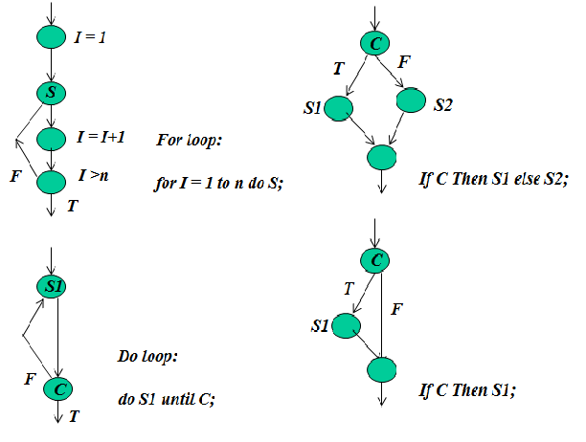
Topic #2 – Software Basis Path Testing
Software Testing
Typical Control Structures
Notes:
What is a software error?
Definition #1:
“A mismatch between the program and its specification is an error in the program if and only if the specification exists and is correct.”
Definition #2:
“A software error is present when the program does not do what its end user reasonability expects to do.” (Myers, 1976)
Definition #3:
“There can never be an absolute definition for bugs, nor an absolute determination of their existence. The extent to which a program has bugs is measured by the extent to which it fails to be useful. This is a fundamentally human measure.” (Besizer, 1984)

Slide 5
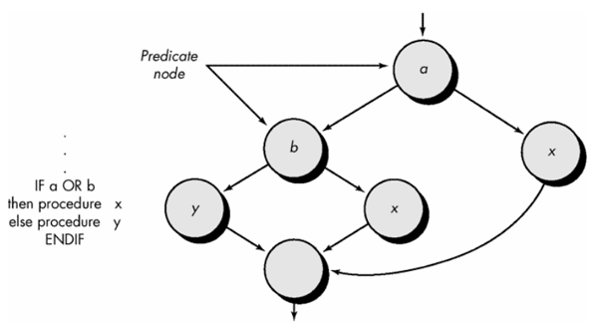
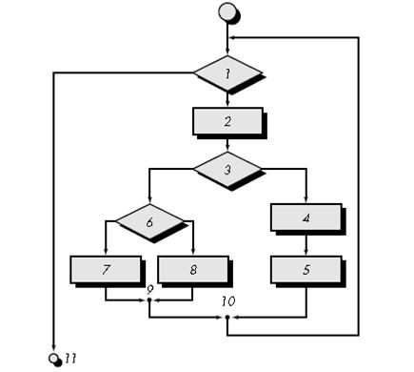
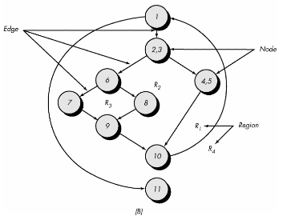
Topic #2 – Software Basis Path Testing
Software Testing
Program Flow Graph Example

Slide 6
Topic #2 – Software Basis Path Testing
Software Testing
Cyclomatic Complexity
What is Cyclomatic complexity?
Cyclomatic complexity is a software metric (developed by Thomas J. McCabe, Sr. in 1976)
It is used to indicate the complexity of a program.
It is a quantitative measure of the complexity of programming instructions. It directly measures the number of linearly independent paths through a program's source code.
Cyclomatic complexity is computed using the control flow graph of a program.
One testing method, called Basis path testing (proposed by McCabe).
It is useful to test each linearly independent path through the program.

Slide 7
Topic #2 – Software Basis Path Testing
Software Testing
Cyclomatic Complexity
Cyclomatic complexity is computed using the control flow graph of a program.
Let M(G) represents the cyclomatic complexity of a program flow graph G.
N stands for the node set in G, and E stands for the edge set in G.
P stands for the predicate node set in G.
Three ways to compute cyclomatic complexity for a program:
#1: M(G) = No. of regions in G
#2: M(G) = |E| - |N| +2
Where |E| is the number of edges and |N| is the number of nodes.
#3: M(G) = |P| + 1
Where |P| is the number of predicate nodes in the flow graph G.

Slide 8
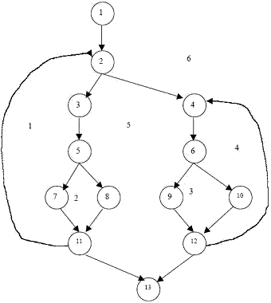
Topic #2 – Software Basis Path Testing
Software Testing
Cyclomatic Complexity Computation
Predicate node
e1
R6
M(G) = 6 regions
e3
e2
M(G) = |E| - |N| +2
= 17 – 13 + 2 = 6
R1
e4
R5
e11
R4
e6
e5
e12
e13
M(G) = |P| + 1
= 5 + 1 =6
e9
R3
R2
e15
e7
e8
e14
e16
e10
e17
Notes:
What is a software error?
Definition #1:
“A mismatch between the program and its specification is an error in the program if and only if the specification exists and is correct.”
Definition #2:
“A software error is present when the program does not do what its end user reasonability expects to do.” (Myers, 1976)
Definition #3:
“There can never be an absolute definition for bugs, nor an absolute determination of their existence. The extent to which a program has bugs is measured by the extent to which it fails to be useful. This is a fundamentally human measure.” (Besizer, 1984)

Slide 9
Topic #2 – Software Basis Path Testing
Software Testing
Basis Path Testing Method
Step 1 : Draw a corresponding flow graph based on program codes
Step 2: Compute the cyclomatic complexity
Step 3: Determine a minimum basis set of linearly independent paths.
For example,
path 1: 1-2-3-5-7-11-13
path 2: 1-2-3-5-8-11-13
path 3: 1-2-3-5-8-11-2-3-5-7-11-13
path 4: 1-2-4-6-9-12-13
path 5:1-2-4-6-10-12-13
path 6: 1-2-4-6-10-12-4-6-9-12-13
Step 4: Prepare a test case for each path in the set.
Step 5: Run the test cases and check their results
e1
e2
R6
e3
R1
e4
R5
e11
R4
e6
e5
e12
e13
e9
R3
R2
e15
e7
e8
e14
e16
e10
e17
Notes:
What is a software error?
Definition #1:
“A mismatch between the program and its specification is an error in the program if and only if the specification exists and is correct.”
Definition #2:
“A software error is present when the program does not do what its end user reasonability expects to do.” (Myers, 1976)
Definition #3:
“There can never be an absolute definition for bugs, nor an absolute determination of their existence. The extent to which a program has bugs is measured by the extent to which it fails to be useful. This is a fundamentally human measure.” (Besizer, 1984)

Slide 10
Topic #2 – Software Basis Path Testing
Software Testing
Basis Path Testing Tips
Simple tips to form your basis path set:
Add your basis path incrementally. (one by one)
Check the redundant path whenever you add one path,
Make sure that new path has at least one new node or new link comparing with the rest paths in the set.
Make sure the total no. of basis paths in the set is equal to your cyclomatic complexity.
Simple tips to form your basis path test set:
Make sure each basis path is executable based on inputs.
Make sure to find the expected outputs based on your inputs for each test case.
Notes:
What is a software error?
Definition #1:
“A mismatch between the program and its specification is an error in the program if and only if the specification exists and is correct.”
Definition #2:
“A software error is present when the program does not do what its end user reasonability expects to do.” (Myers, 1976)
Definition #3:
“There can never be an absolute definition for bugs, nor an absolute determination of their existence. The extent to which a program has bugs is measured by the extent to which it fails to be useful. This is a fundamentally human measure.” (Besizer, 1984)

Slide 11
Compute Cyclomatic Complexity Using Graph Matrix
 | 1 | 2 | 3 | 4 | 5 | 6 | 7 | 8 | 9 | 10 | 11 | 12 | 13
1 | 0 | 1 | 0 | 0 | 0 | 0 | 0 | 0 | 0 | 0 | 0 | 0 | 0
2 | 0 | 0 | 1 | 1 | 0 | 0 | 0 | 0 | 0 | 0 | 0 | 0 | 0
3 | 0 | 0 | 0 | 0 | 1 | 0 | 0 | 0 | 0 | 0 | 0 | 0 | 0
4 | 0 | 0 | 0 | 0 | 0 | 1 | 0 | 0 | 0 | 0 | 0 | 0 | 0
5 | 0 | 0 | 0 | 0 | 0 | 0 | 1 | 1 | 0 | 0 | 0 | 0 | 0
6 | 0 | 0 | 0 | 0 | 0 | 0 | 0 | 0 | 1 | 1 | 0 | 0 | 0
7 | 0 | 0 | 0 | 0 | 0 | 0 | 0 | 0 | 0 | 0 | 1 | 0 | 0
8 | 0 | 0 | 0 | 0 | 0 | 0 | 0 | 0 | 0 | 0 | 1 | 0 | 0
9 | 0 | 0 | 0 | 0 | 0 | 0 | 0 | 0 | 0 | 0 | 0 | 1 | 0
10 | 0 | 0 | 0 | 0 | 0 | 0 | 0 | 0 | 0 | 0 | 0 | 1 | 0
11 | 0 | 1 | 0 | 0 | 0 | 0 | 0 | 0 | 0 | 0 | 0 | 0 | 1
12 | 0 | 0 | 0 | 1 | 0 | 0 | 0 | 0 | 0 | 0 | 0 | 0 | 1
13 | 0 | 0 | 0 | 0 | 0 | 0 | 0 | 0 | 0 | 0 | 0 | 0 | 0
1-1=0
2-1=1
1-1=0
1-1=0
2-1=1
2-1=1
1-1=0
1-1=0
1-1=0
1-1=0
2-1=1
2-1=1
|P|=5
|P| + 1 = 6

Slide 12
Topic #2 – Software Basis Path Testing
Software Testing
Basis Path Testing Coverage
Following the basis path testing method, we can achieve the following
White-box program test coverage for each program.
Source code node coverage:
For each node in a program flow graph, there will be at least one basis path test case exercise it.
Control link coverage:
For each edge in a program flow graph, there will be at least one basis path test case cover it.
Basis path coverage:
For each basis path in the basis path set, there will be at least one
basis test case covering it.
Predicate node coverage:
For each node, there will be at least one basis path test case
covering it.
Notes:
Mistake
– A human action that produces an incorrect result.
Fault [or Defect]
– An incorrect step, process, or data definition in a program.
Failure
– The inability of a system or component to perform its required function within the specified performance requirement.
Error
– the difference between a computed, observed, or measured value or condition and the true, specified, or theoretically correct value or condition.

